Slide 2
GAMS in R {{Generalized Additive Models}}
Gam_1 <- gam( Y ~ s(X1, k=___)+s(X2, by=X4)+X3, sp=___, data=___)
- k= number of functions , sp=smoothing parameter
- X3 = linear variable therefore not ‘s(X3)’ [[can also be categorical factors mgcv does not use characters]]
- by= ____ smooth by each unique category
Gam_1$sp= gives you the “best fit” smoothing parameter

Slide 3
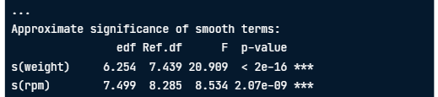
Interpreting summary(gam_mod)
Family = gaussian [means assumes normal distribution of our errors]
- edf = effective degrees of freedom; represents complexity of smooth (edf of 1 is a straight line) __ higher edfs = describing more ‘wiggly’ curves
- Ref.df & F = test stats for overall significance of smooth.. These are used to determine the p-value
Interpretation: you cannot draw a horizontal line with a 95% CI
Smooths can be linear or non-linear (as per edf) and significant or not significant (as per p-value)

